Slide 1
Make a Color
Mr. Neat
Java

Slide 2
Color constructor
Color sue = new Color(int r, int g, int b);
redness
greenness
blueness
color int values range from 0 to 255 inclusive

Slide 3
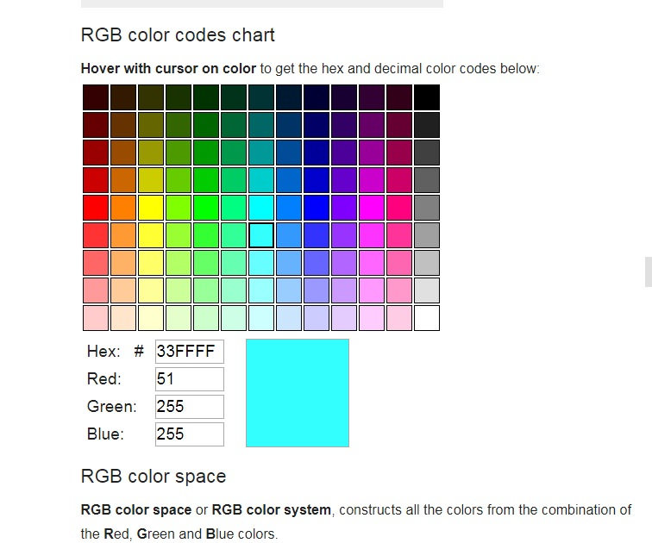

Slide 4

Color tester = new Color(51,255,255);

Slide 5
Rectangle setColor method definition
void setColor(Color c )
parameter
return
type
method
name

Slide 6
Rectangle are = new Rectangle(10,10,10,10);
are.setColor(tester);
are.fill();

Slide 7
Rectangle are = new Rectangle(10,10,10,10);
are.setColor(tester);
are.fill();
note using fill() - inside
instead of draw() - perimeter

Slide 8
Lab
make one large Rectangle object
make a random Color
make the Rectangle the random Color
be sure to use the fill() method

